Slide 1
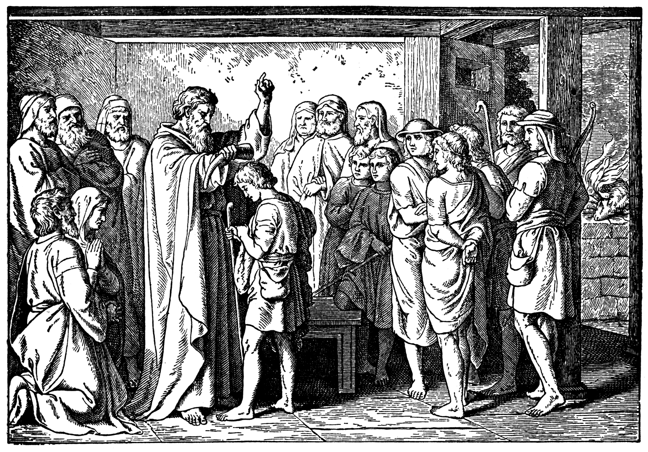
God Provides Himself a King – Part 3

Slide 2
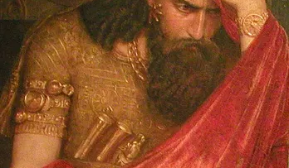
An Evil Spirit.
You are submitted to one of two authorities.

Slide 3
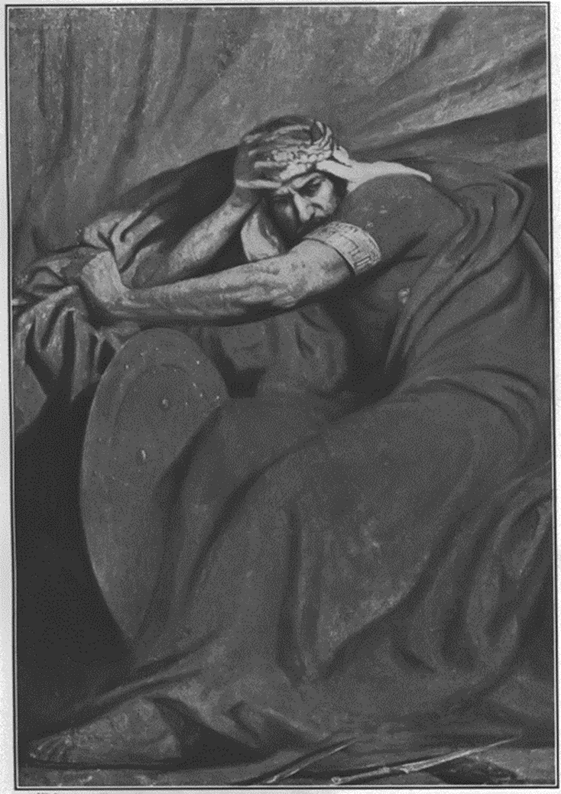
A Wise Solution
Saul was oblivious.
His problem was obvious!
KEY – speak up when you see something is wrong.
Saul is surrounded by faith filled people. They are looking for a spiritual solution.
The devil hates our worship of God. He wants it for himself.

Slide 4
Isaiah 14:12-14 How art thou fallen from heaven, O Lucifer, son of the morning! how art thou cut down to the ground, which didst weaken the nations! 13 For thou hast said in thine heart, I will ascend into heaven, I will exalt my throne above the stars of God: I will sit also upon the mount of the congregation, in the sides of the north: 14 I will ascend above the heights of the clouds; I will be like the most High.

Slide 5
Luke 4:5-7 And the devil, taking him up into an high mountain, shewed unto him all the kingdoms of the world in a moment of time. 6 And the devil said unto him, All this power will I give thee, and the glory of them: for that is delivered unto me; and to whomsoever I will I give it. 7 If thou therefore wilt worship me, all shall be thine.

Slide 6
Luke 4:8 And Jesus answered and said unto him, Get thee behind me, Satan: for it is written, Thou shalt worship the Lord thy God, and him only shalt thou serve.

Slide 7
Entrench in worship of God, and watch the devil run.
James 4:7 Submit yourselves therefore to God. Resist the devil, and he will flee from you.

Slide 8
A Selfish Monarch.
Saul’s priorities
are always on Saul.

Slide 9
1 Samuel 8:11 And he said, This will be the manner of the king that shall reign over you: He will take your sons, and appoint them for himself, for his chariots, and to be his horsemen; and some shall run before his chariots.

Slide 10
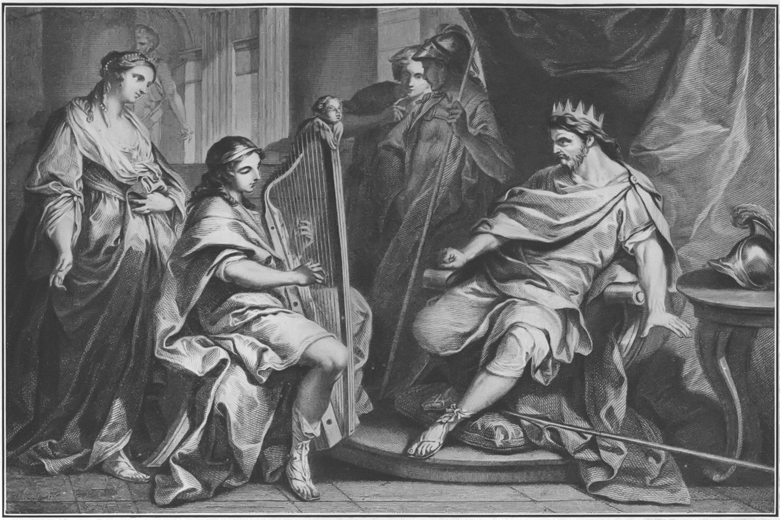
A Proven Minister.
David has a rep!
  A proven worshiper.

Slide 11
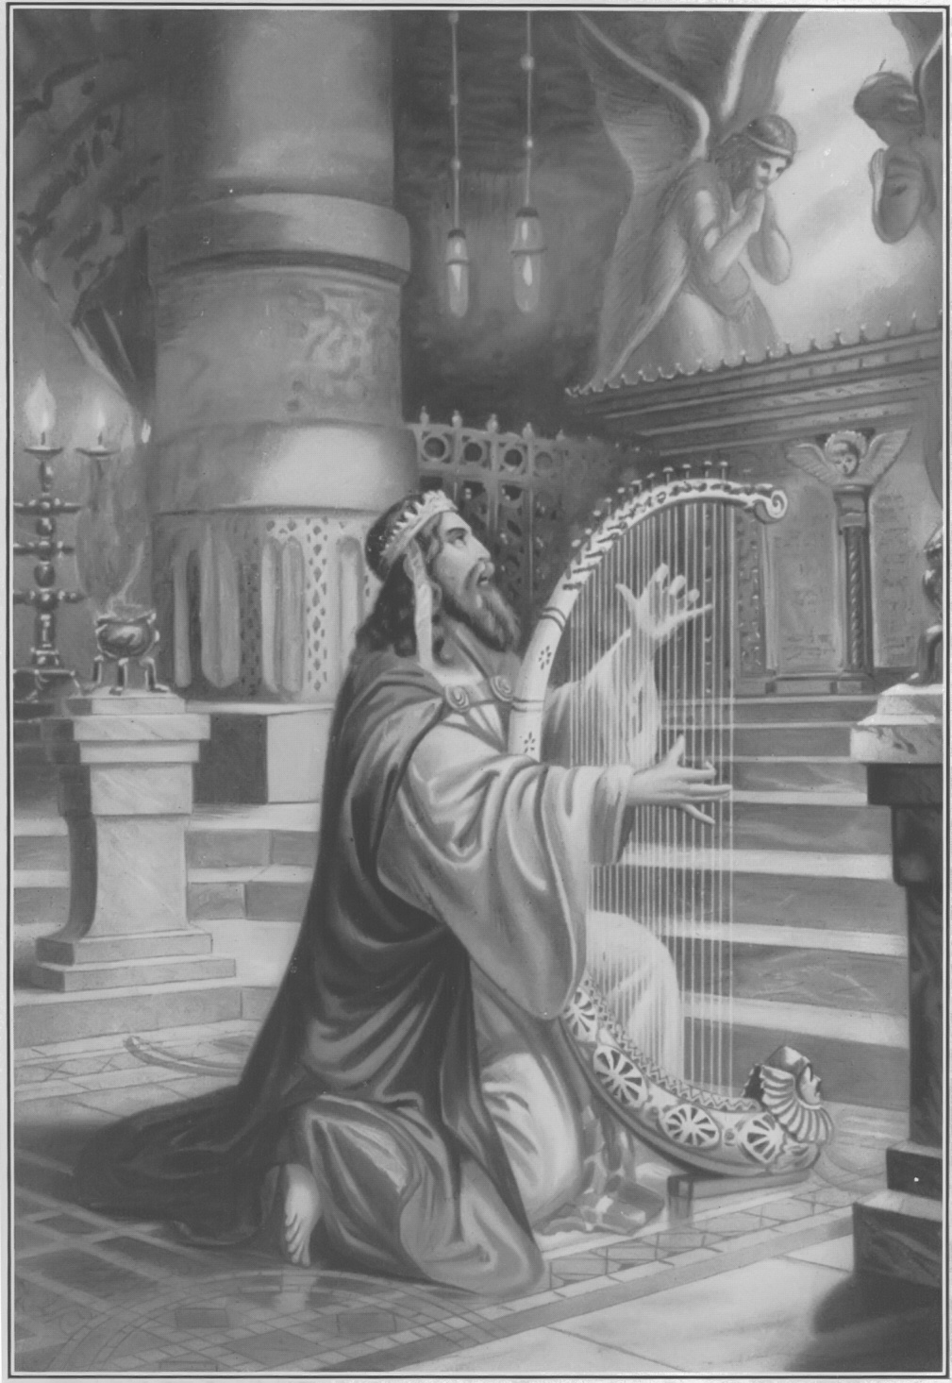
2 Samuel 23:1 Now these be the last words of David. David the son of Jesse said, and the man who was raised up on high, the anointed of the God of Jacob, and the sweet psalmist of Israel, said,

Slide 12
1 Chronicles 23:5 Moreover four thousand were porters; and four thousand praised the LORD with the instruments which I made, said David, to praise therewith.

Slide 13
Our worship should be extravagant.
God is worth it.

Slide 14
A Proven Minister.
David has a rep!
  A proven worshiper.
  A proven man of war.

Slide 15
1 Samuel 17:34-35 And David said unto Saul, Thy servant kept his father's sheep, and there came a lion, and a bear, and took a lamb out of the flock: 35 And I went out after him, and smote him, and delivered it out of his mouth: and when he arose against me, I caught him by his beard, and smote him, and slew him.

Slide 16
A Proven Minister.
David has a rep!
  A proven worshiper.
  A proven man of war.
  A proven man of wisdom.

Slide 17
Ephesians 5:15-16 See then that ye walk circumspectly, not as fools, but as wise, 16 Redeeming the time, because the days are evil.

Slide 18
A Proven Minister.
David has a rep!
  A proven worshiper.
  A proven man of war.
  A proven man of wisdom.
  A proven man of beauty.
  A proven walk with God.

Slide 19
1 Samuel 18:12-15 And Saul was afraid of David, because the LORD was with him, and was departed from Saul. 13 Therefore Saul removed him from him, and made him his captain over a thousand; and he went out and came in before the people. 14 And David behaved himself wisely in all his ways; and the LORD was with him. 15 Wherefore when Saul saw that he behaved himself very wisely, he was afraid of him.

Slide 20
Genesis 26:28 And they said, We saw certainly that the LORD was with thee: and we said, Let there be now an oath betwixt us, even betwixt us and thee, and let us make a covenant with thee;
Genesis 39:2-3 And the LORD was with Joseph, and he was a prosperous man; and he was in the house of his master the Egyptian. 3 And his master saw that the LORD was with him, and that the LORD made all that he did to prosper in his hand.
Genesis 39:23 The keeper of the prison looked not to any thing that was under his hand; because the LORD was with him, and that which he did, the LORD made it to prosper.

Slide 21
Joshua 3:7 And the LORD said unto Joshua, This day will I begin to magnify thee in the sight of all Israel, that they may know that, as I was with Moses, so I will be with thee.
Joshua 6:27 So the LORD was with Joshua; and his fame was noised throughout all the country.

Slide 22
Judges 2:18 And when the LORD raised them up judges, then the LORD was with the judge, and delivered them out of the hand of their enemies all the days of the judge: for it repented the LORD because of their groanings by reason of them that oppressed them and vexed them.
1 Samuel 3:19 And Samuel grew, and the LORD was with him, and did let none of his words fall to the ground.

Slide 23
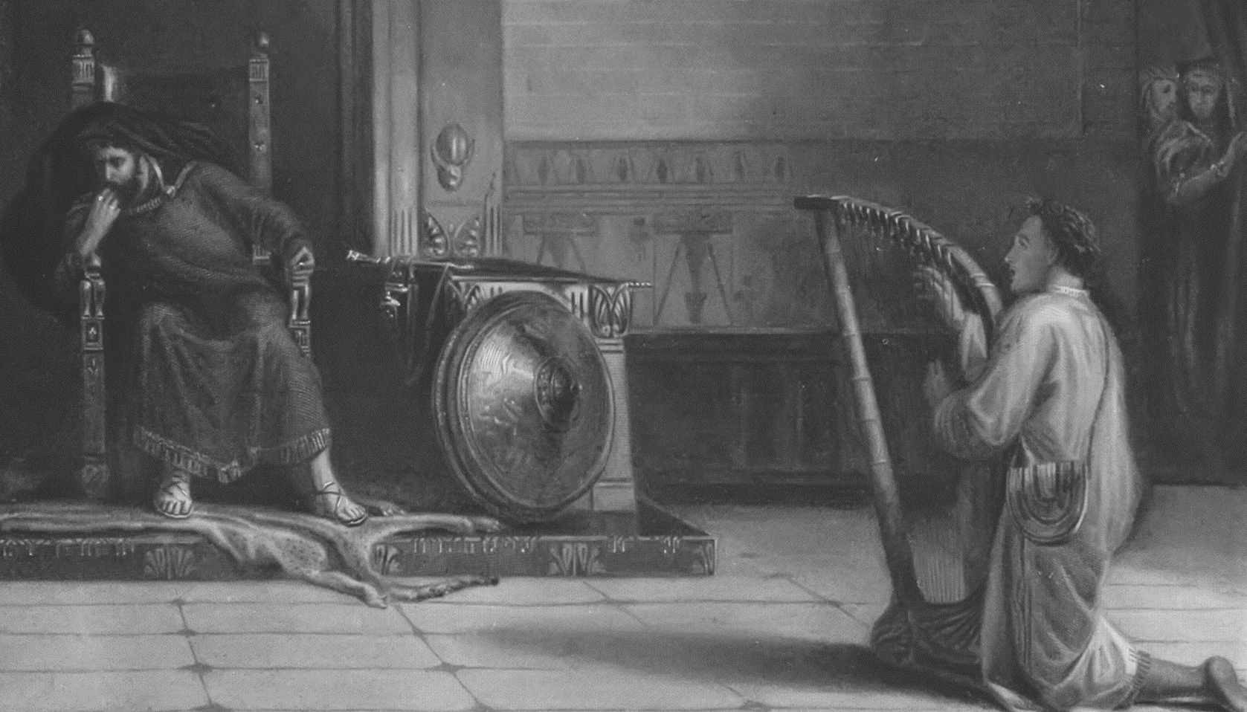
A Proven Minister.
God prepared David for the work He called David to.
God has called and is preparing us too!

Slide 24
Galatians 1:15-16 But when it pleased God, who separated me from my mother's womb, and called me by his grace, 16 To reveal his Son in me, that I might preach him among the heathen; immediately I conferred not with flesh and blood:

Slide 25
Jeremiah 1:4-10 Then the word of the LORD came unto me, saying, 5 Before I formed thee in the belly I knew thee; and before thou camest forth out of the womb I sanctified thee, and I ordained thee a prophet unto the nations.
9 Then the LORD put forth his hand, and touched my mouth. And the LORD said unto me, Behold, I have put my words in thy mouth. 10 See, I have this day set thee over the nations and over the kingdoms, to root out, and to pull down, and to destroy, and to throw down, to build, and to plant.

Slide 26
Jesse’s submission.

Slide 27


Slide 28
Ministry takes you out of your comfort zone.

Slide 29
John 21:18 Verily, verily, I say unto thee, When thou wast young, thou girdedst thyself, and walkedst whither thou wouldest: but when thou shalt be old, thou shalt stretch forth thy hands, and another shall gird thee, and carry thee whither thou wouldest not.

Slide 30
1 Corinthians 6:19-20 What? know ye not that your body is the temple of the Holy Ghost which is in you, which ye have of God, and ye are not your own? 20 For ye are bought with a price: therefore glorify God in your body, and in your spirit, which are God's.

Slide 31
God Provides Himself a King

